Slide 1
Analyzing amazon sales data
Project By: Sakshi Fand

Slide 2
Problem Statement
Sales management has gained importance to meet increasing competition and the need for improved methods of distribution to reduce cost and to increase profits. Sales management today is the most important function in a commercial and business enterprise.
Extract-Transform-Load some Amazon dataset and find for me Sales-trend -> month-wise, year-wise, yearly_month-wise,
Finding key metrics and factors and show the meaningful relationships between attributes.

Slide 3
Details of data
Region
Country
Sales Channel
Order priority
Order Id
Ship date
Unit cost
Unit Price
Unit solds
Total Revenue
Total Cost
Total profit

Slide 4
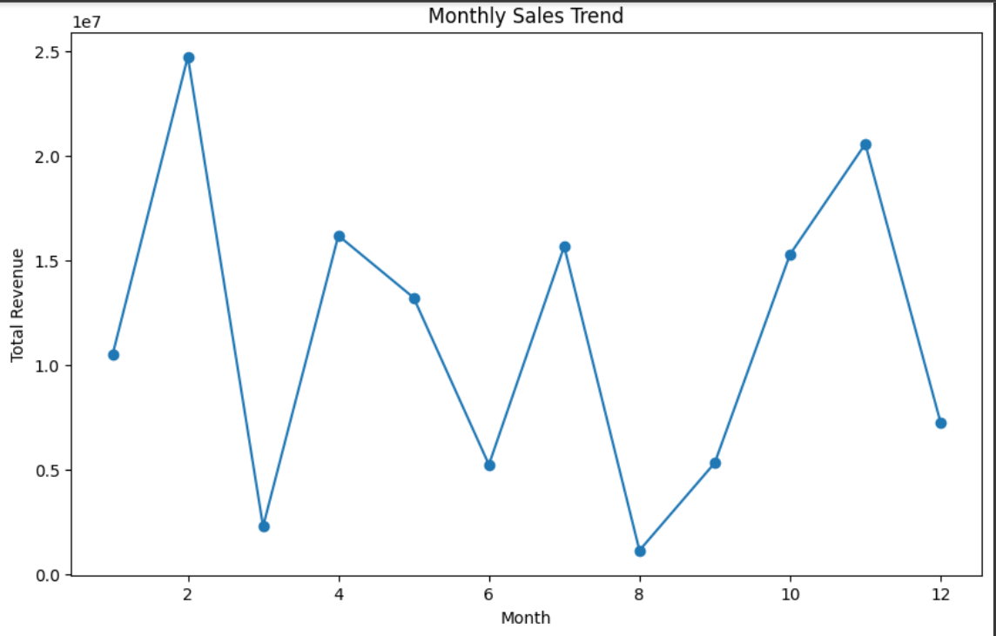
Visuals

Slide 5
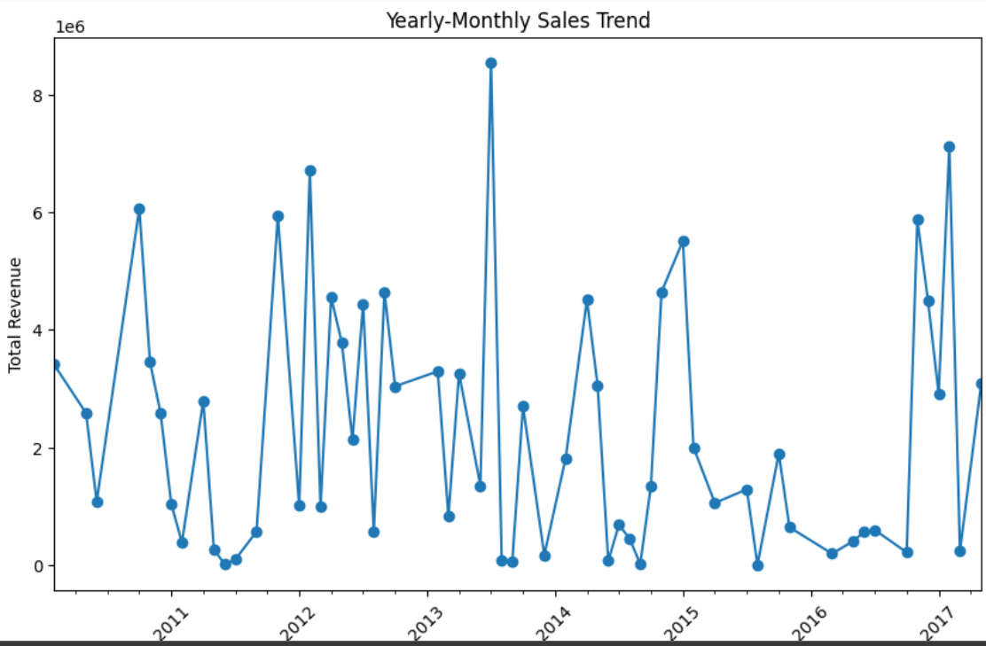

Slide 6
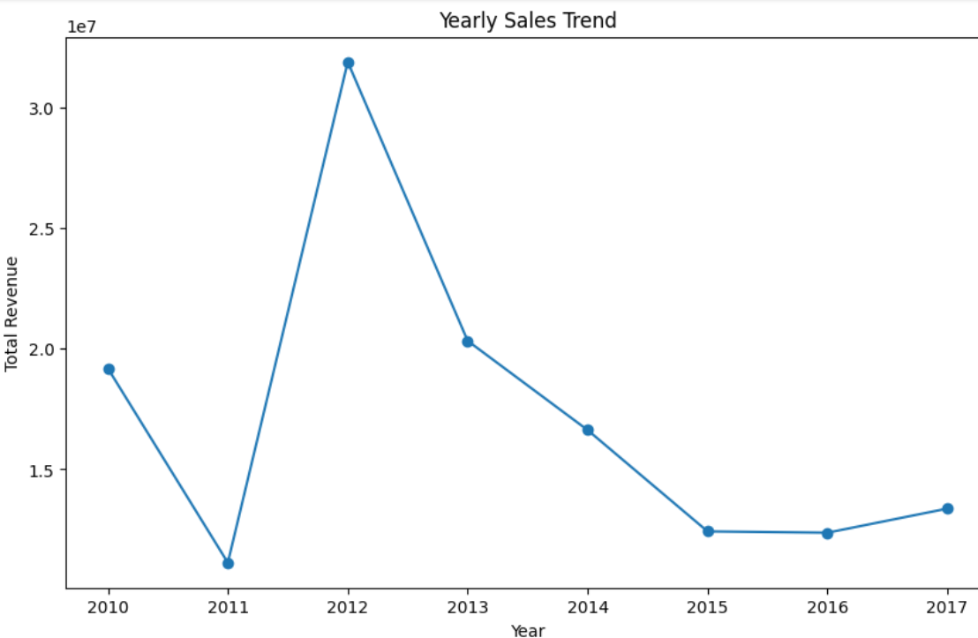

Slide 7
insights
From Sales Trend analysis we note that the overall sales. have been decreasing and increasing.(Sales were observed especially low in the year 2016)
The Most High Selling & Profitable product types are:
Cosmetics
Office Supplies
Household
The Least Selling & Least Profitable products are:
Fruits----------- 466481.34
Snacks----------- 2080733.46
Beverages-------- 2690794.60

Slide 8
Thank you

